Slide 1


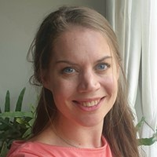




Speaker
Barbara Forbes
GitHub CoPilot and PowerShell
Barbara Forbes
Ba4bes
September 16th & 17th
^{Online Event}
Powered By
International Conference

